Slide 1
Presentation on Constraints in Enforcement of Environmental Regulations with reference to Prevention & Control of Water Pollution at Conference on Formulation of Science Based Environment Policy for the State of Maharashtra
by
Dr. Dilip B. Boralkar
Mumbai, April 20-21, 2016

Slide 4
Functions of the Board 2
to evolve efficient methods of disposal
to lay down standards of treatment of sewage and trade effluents to be discharged into any particular stream taking into account the minimum fair weather dilution available in that stream and the tolerance limits of pollution permissible in the water of the stream, after the discharge of such effluents;
to make, vary or revoke any order
to advise the State Government with respect to the location of any industry the carrying on of which is likely to pollute a stream or well;
to establish or recognise a laboratory or laboratories

Slide 5
Historical
Environment Action Plan
Policy Statement on P&CP of Pollution
SC Order based on Menon Committee recommendations.
1) The Bhattacharjee Committee, 1984
2) The Belliappa Committee, 1990
3) The ASCI Study, 1994
4) Study of the Sub-Group, 1994 (Planning Commission)
Parliamentary Committee on S&T and E,F&CC
CRISIL, Mumbai (MPCB)
IIM Lucknow (CPCB)
MoEF Direction dated 27.07.2005 and thereafter HCs and NGT
Functions of the Board

Slide 6
Perfection of Goal and Objectives!
Vision Statement 2004
“Improvement in Board’s
Functional Efficiency,
Transparency in Operations and
Adequate Response to Growing Needs of Environmental Protection and
Sustainable Development
in the State of Maharashtra”

Slide 7
Functions of the Board 1
to plan a comprehensive P&CP programme and secure the execution
to advise the State Government
to collect and disseminate information
to encourage, conduct and participate in investigations and research
to organise the training and mass education
to inspect sewage or trade effluents, works and treatment plants
to lay down, modify or annul effluent standards
to evolve economical and reliable methods
to evolve methods of utilisation of sewage and suitable trade effluents

Slide 8
Goals
Transparent and speedy operations
Improvement in Analytical Capabilities
Judicious use of Punitive Powers
Improved Infrastructure !
Timely Response
Increased involvement of R&D organizations & Educational Institutes in Research & Pollution Monitoring Activities
Involvement of experts & private agencies in achieving the specialized tasks
Pollution Awareness and Action !
Response to the location specific needs
MSW, BMW, HW & other wastes

Slide 9
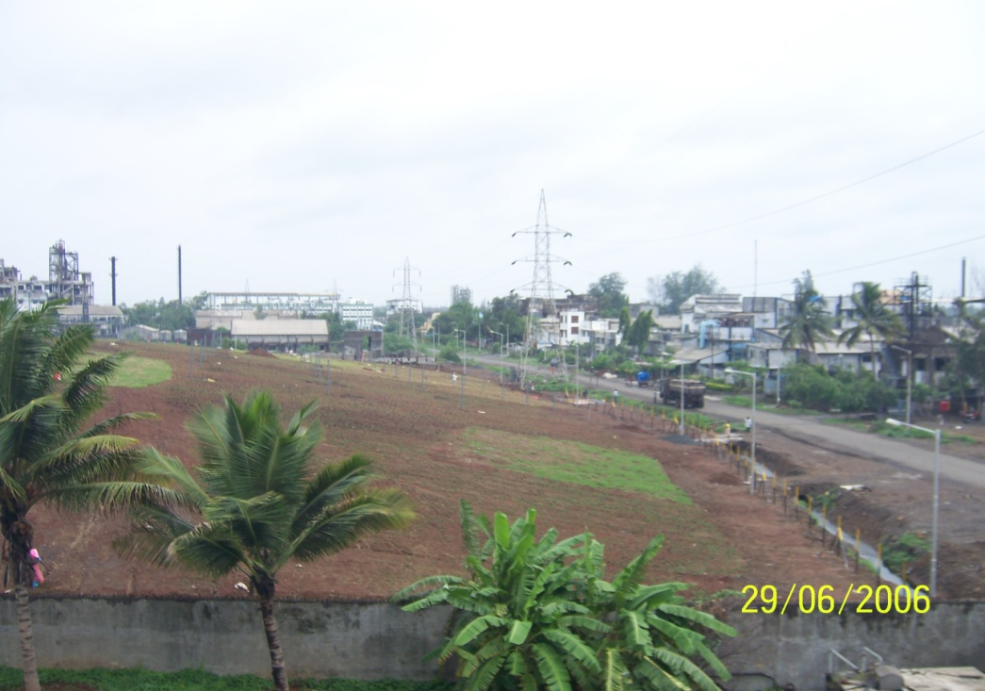
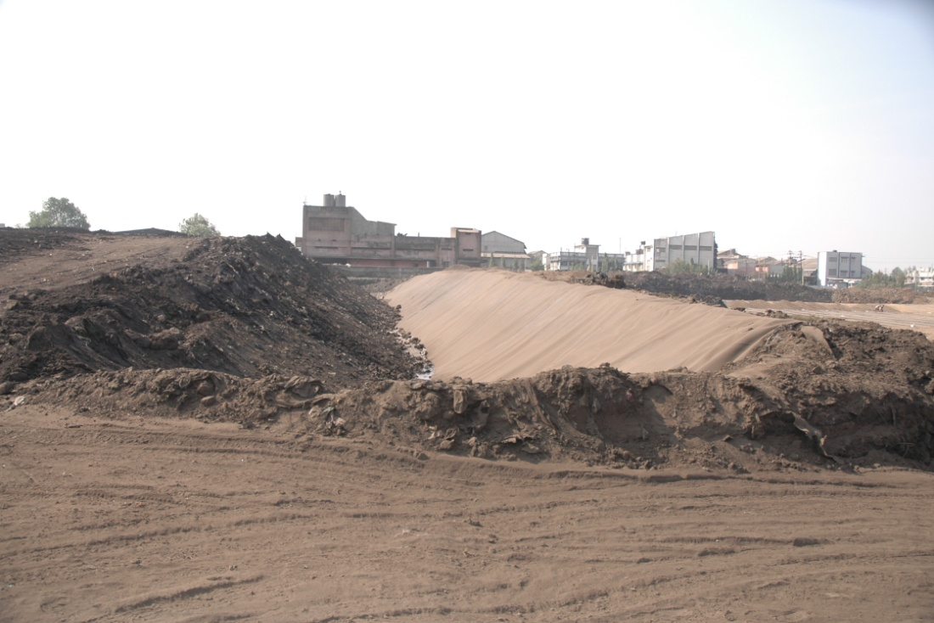
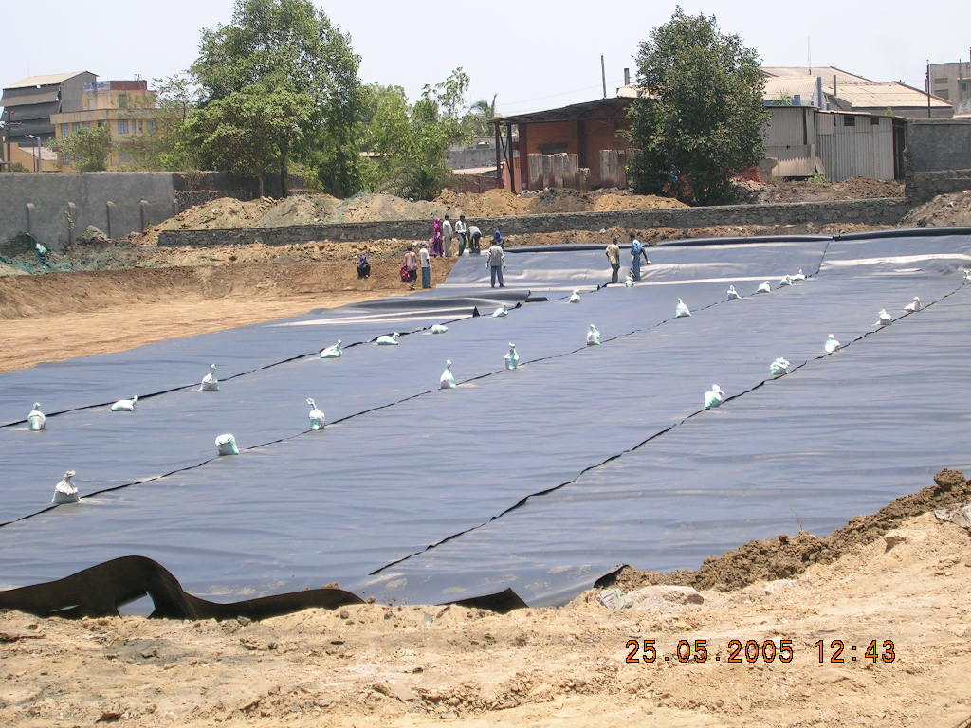
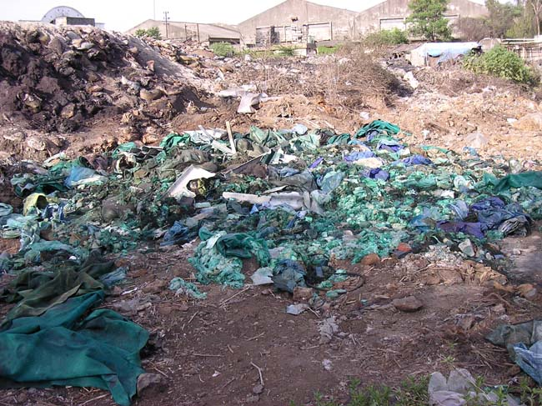
CLEAN UP AND DISPOSAL (Section 30)
Final Coating of SLF
Encapsulation of SLF
SLF
Illegal Dump Site

Slide 10
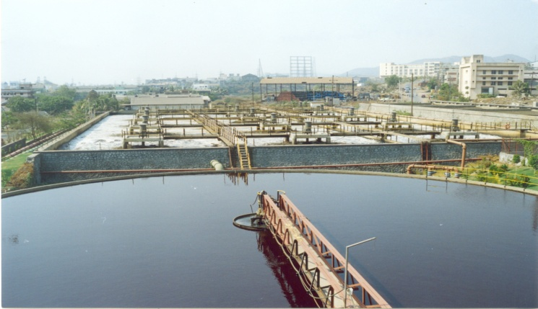
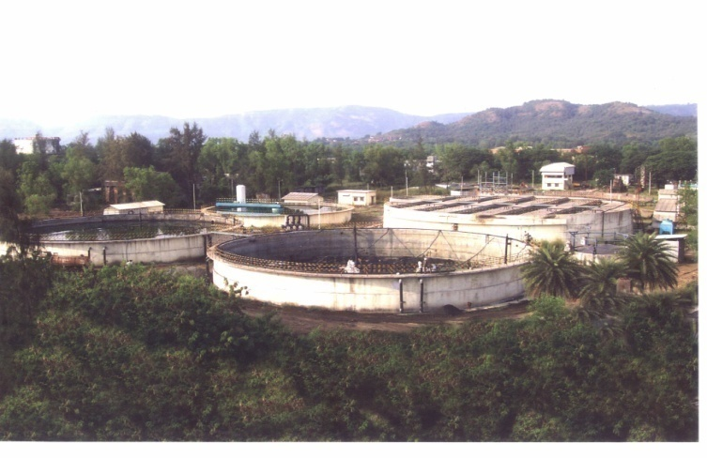
CETP : Issues
Diurnal variations in the quantity and quality of the effluent
Frequent Changes in the product Qly & Qty
Up-gradation in terms of technology, infrastructure,
Inability of SMEs to invest large sums without support from MIDC and MPCB as was given in the beginning.
Problems of refractory COD.
Policy decisions : Re-Finance, Recycling/Reuse etc. at CETP.

Slide 11
CETP: Way Forward
Assessment of requirements of up-gradation / strengthening
Waste recovery units. E.g. solvent & acid recovery
Plans for to utilisation of Environment Cess fund of MIDC and Funds of MPCB for repairing/improving the infrastructure for effluent conveyance to CETP and for supporting CETP improvement in terms of additional treatment units, resources recovery units and reuse/recycling of treated effluent.
Regulatory SOPs and trainings for O&M/trouble shooting required.
Mandatory Certificate for CETP/ETP operators and Supervisors.
Prepare Time Bound Action Plan for compliance: short and medium term targets for by CETPs, MIDC and MPCB.

Slide 12
Surface water P&CP
Rivers and Lakes
Coastal waters
Drinking water resources
Reuse and Recycling
Zero Liquid Discharge
Waste minimization & LNWT

Slide 13
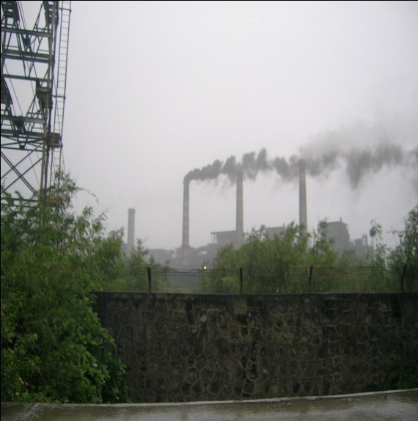
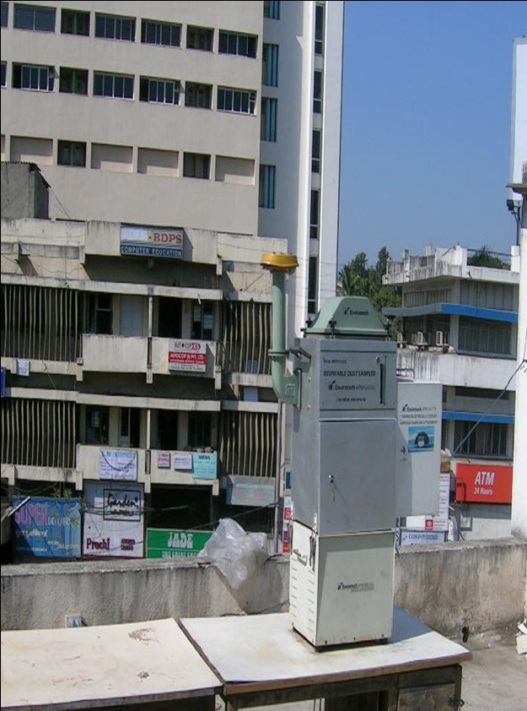
Environment Monitoring
Air
Daily Air Quality reported on website
Continuous AQMS
Plan and cause to execute health study
Mobile Air Monitoring Van
Collaborate with SAFAR
Water
GEMS / MINARS
Increase
Private Sector/Educational Institutes
QA QC
Drinking water sources
Ground water
State Water Quality Reports
Chair in University

Slide 14
Institutional Capacity Building
Re-engineering of internal setup (sector specific divisions for pollution control implementation)
Performance evaluation of the Board
Right-sizing of administration
Development & Implementation of Time Bound strategic action plan
Rapid response to public complaints
Creation of new post, recruitment and promotions
Employees pension, medical attendance, education subsidy, canteen subsidy, housing etc.
QIP: Study Leave,
Sports & Cultural Activities,

Slide 15
Proactive Initiatives for Protection of Environment (PIPE)
Strategic Action Plan (SAP)
Internal Capacity Building (ICB)
Area Specific Action Plan
Industry Specific Action
Public Opinion Regarding Deve. of Infra. & Core Industry
Public Participation in Pollution Control Programs
Environmental Improvement at Religious Places
Pollution Assessment and Monitoring of Coastal Water
Strengthening of Air Quality Monitoring Network
Health Studies (e.g. Incidence of Asthma)

Slide 16
PIPE
Rejuvenation of NGC Activities
Green Budget
Environmental Technology Promotion and Financing Corporation (ETPFC)
Environmentally Biased Program for Woman and Children
Mobilization of Million Young People for Protection of Environment
Mobilization of Million Young People for Protection of Environment
Disaster Management Centre
Coastal Zone Management
Climate Change and Global Warming

Slide 17
AGENDA 2016 – 2021
Common Infrastructure for environment protection | Setting up SPV to facilitate PPP Promotion of CETP. CHWTSDF, CFBMW, MSW, Plastics, E Waste, C&D Waste,
Specific actions for pollution control | Implementation of action plans for P&CP Sectoral initiatives: sponge iron, induction furnace, mining, pesticides, power plants, distilleries, STPs for ULBs etc.
Environmental Surveillance and monitoring | Setting up of additional air and water (surface and GW) monitoring stations Environmental surveillance and monitoring Impact studies and R&D promotion Web based real time availability of industrial emission data

Slide 18
AGENDA 2016 – 2021
Internal capacity building | Automation Establishment of new Offices /Labs Strengthening of infrastructure laboratories for HAP, VOC and calibration of instruments. Training and improvement in service conditions of employees
Public awareness and action centre (PAAC) | Environmental information kiosk Web based dissemination of information Pollution awareness and assistance centre Campaign through media
Special Projects | Environmental improvement at religious places Finger print analysis and data base for hazardous waste. Strengthening emergency response centre for chemical accidents. Demonstration projects for MSW, BMW etc.

Slide 19

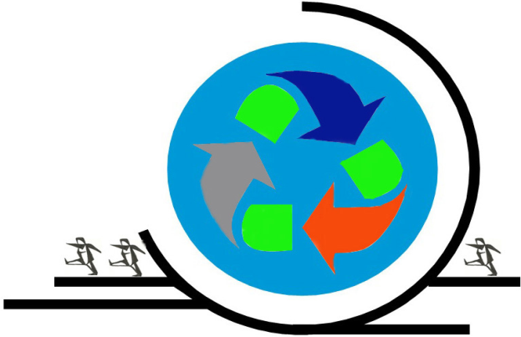
Thanks very much e mail: dbboralkar@gmail.com Website: www.boralkar.com

